Slide 1

Module 2- Big Data Infrastructure
Hadoop Ecosystem- Ambari

Slide 2

Hadoop Ecosystem
Ambari History
Ambari introduced in late 2012
Ambari top project of apache graduated in 2013
First of its own kind of tool
Ambari currently supports the 64-bit version of the following Operating Systems:
RHEL (Redhat Enterprise Linux) 7.6, 7.5, 7.4, 7.3, 7.2
CentOS 7.6, 7.5, 7.4, 7.3, 7.2
OEL (Oracle Enterprise Linux) 7.6, 7.5, 7.4, 7.3, 7.2
Amazon Linux 2
SLES (SuSE Linux Enterprise Server) 12 SP4, 12 SP3, 12 SP2
Ubuntu 14, 16 and 18
Debian 9

Slide 3
Hadoop Ecosystem
Why Apache Ambari?
Simplifies Installation, Configuration and Management
Easy, efficient, repeatable creation of clusters
Manages and Monitors clustering

Slide 4
Hadoop Ecosystem
Ambari Goals
Provision of Hadoop Cluster
Solely responsible for Hadoop Cluster irrespective of cluster size and number of nodes
Uses RESTApis to automate installation of Hadoop cluster
Configuration is done very easily with Webfront
Integration with other tools
Possess RESTApi to connect to different tools in the market.
Ingest data from different data sources to HDFS easily

Slide 5
Hadoop Ecosystem
Ambari Goals
Monitoring the Cluster
Dashboard for monitoring the status and health of Hadoop Cluster.
Ambari metrics and alert systems to gather information
Manage the Cluster
Central management of services for starting, stopping and reconfiguration.
Simplifies the whole process of Management

Slide 6
Hadoop Ecosystem
Features of Apache Ambari
Platform Independent
Pluggable Component
Version Management and upgraded
Extensibility
Failure Recovery
Security

Slide 7
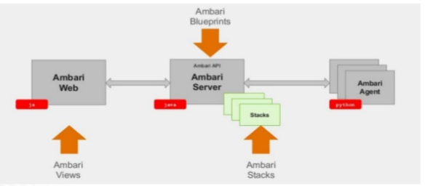
Hadoop Ecosystem
Ambari Architecture
Components are
Ambari Server
Agents
Metric Collector
Alert Mechanism
Ambari Stacks
Describes the applications to be installed,
eg, Hadoop, its components and its structure
Ambari Blueprints
Creation of the cluster
Ambari Views
User interface
Source: https://www.slideshare.net/hortonworks/managing-enterprise-hadoop-clusters-with-apache-ambari

Slide 8
Hadoop Ecosystem
What we need to do in Ambari to define a Cluster?
Term | Meaning
Stack | Set of services, where to get the software packages, e.g. HDP (Hortonworks Data Platform)
Service | Components that make up the service e.g, HDFS
Component | Building blocks of the service – Namenode, Datanode
Category | Master, slave, client

Slide 9
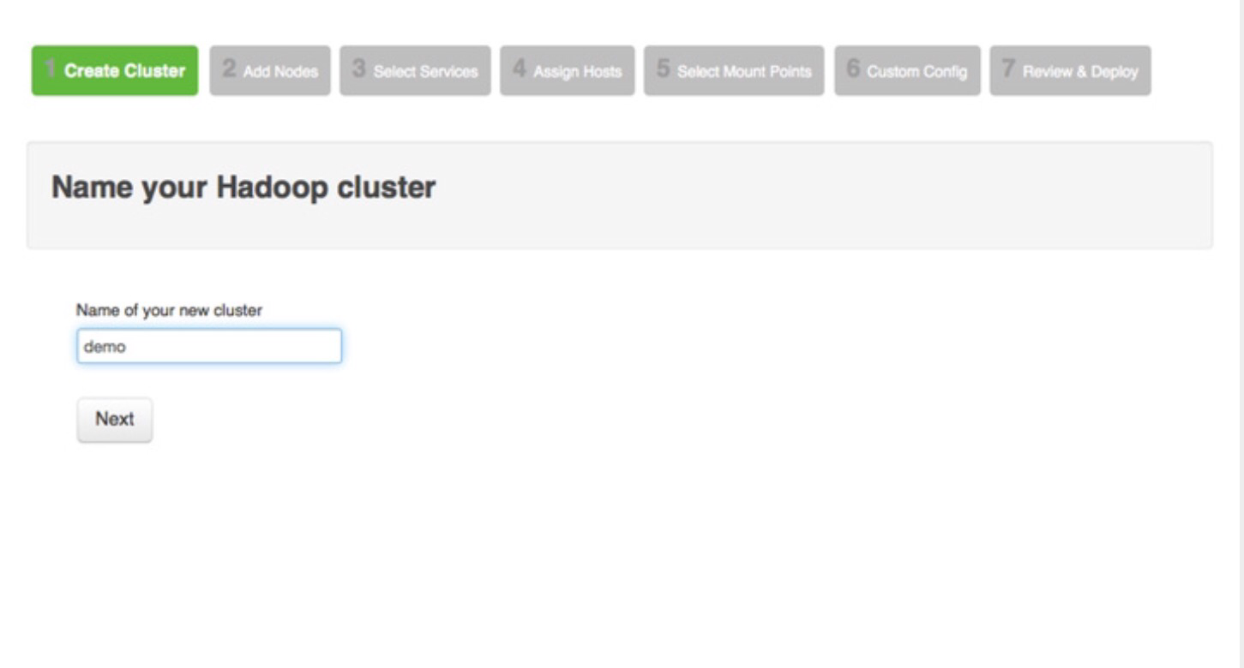
Hadoop Ecosystem
Deploy and Manage Hadoop Clusters

Slide 10
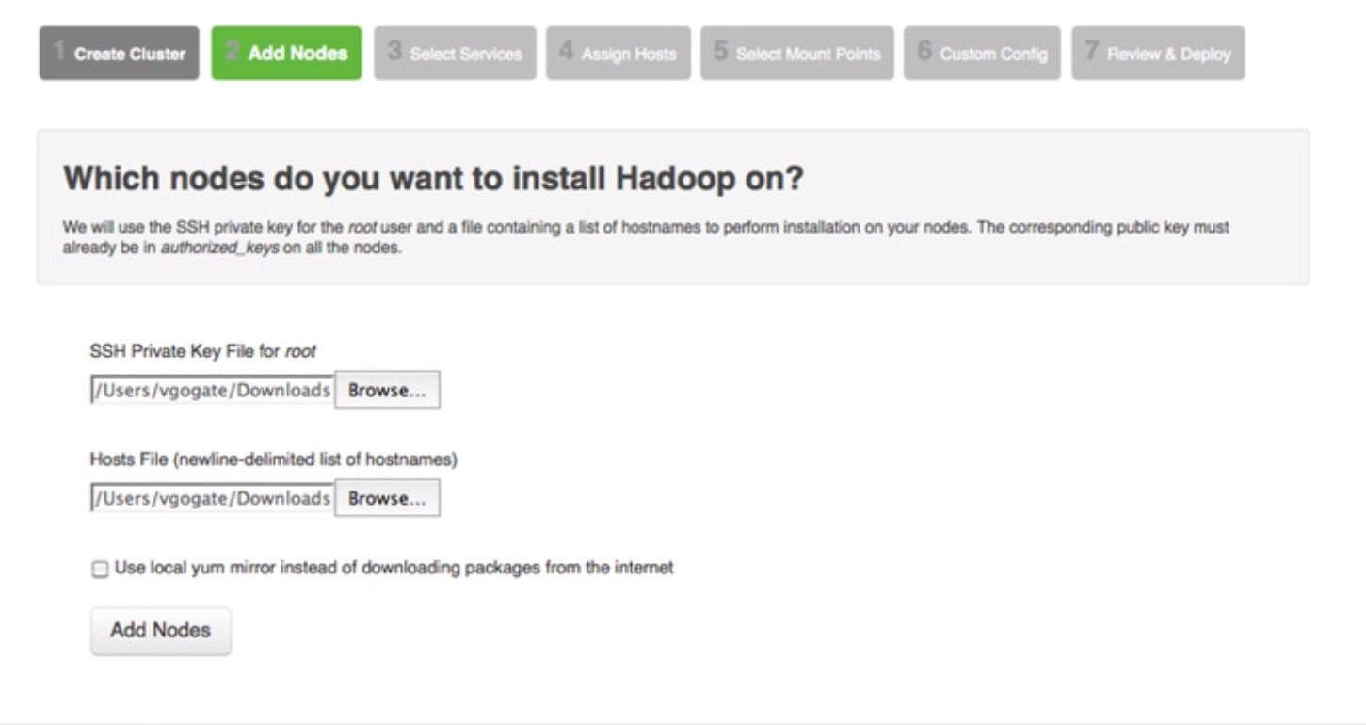
Hadoop Ecosystem
Ambari- Adding Nodes

Slide 11
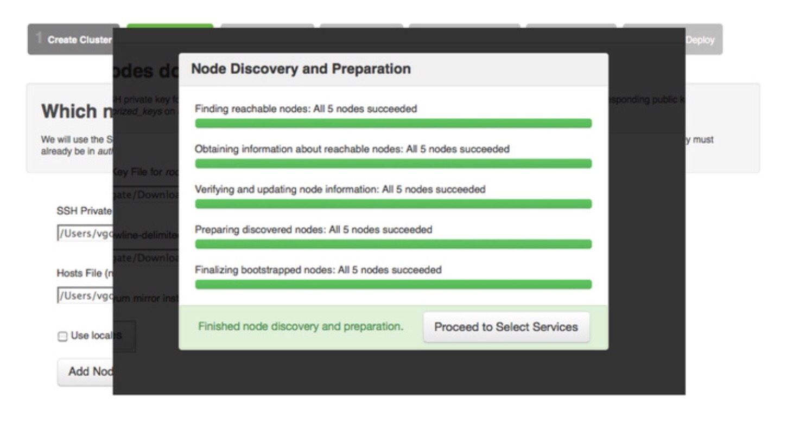
Hadoop Ecosystem
Ambari-Adding Nodes

Slide 12
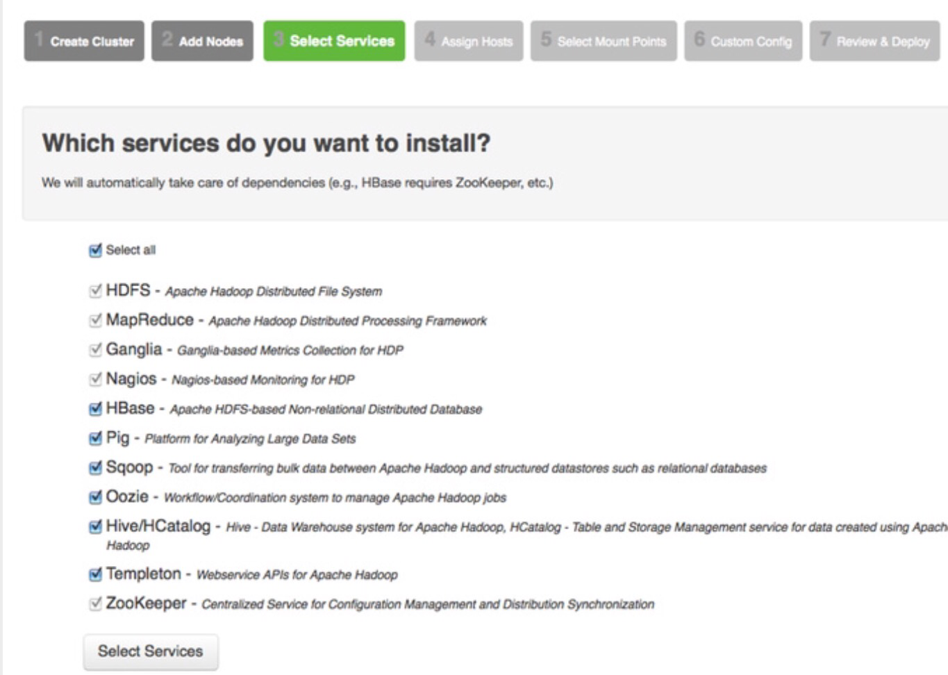
Hadoop Ecosystem
Service Selection in Cluster

Slide 13
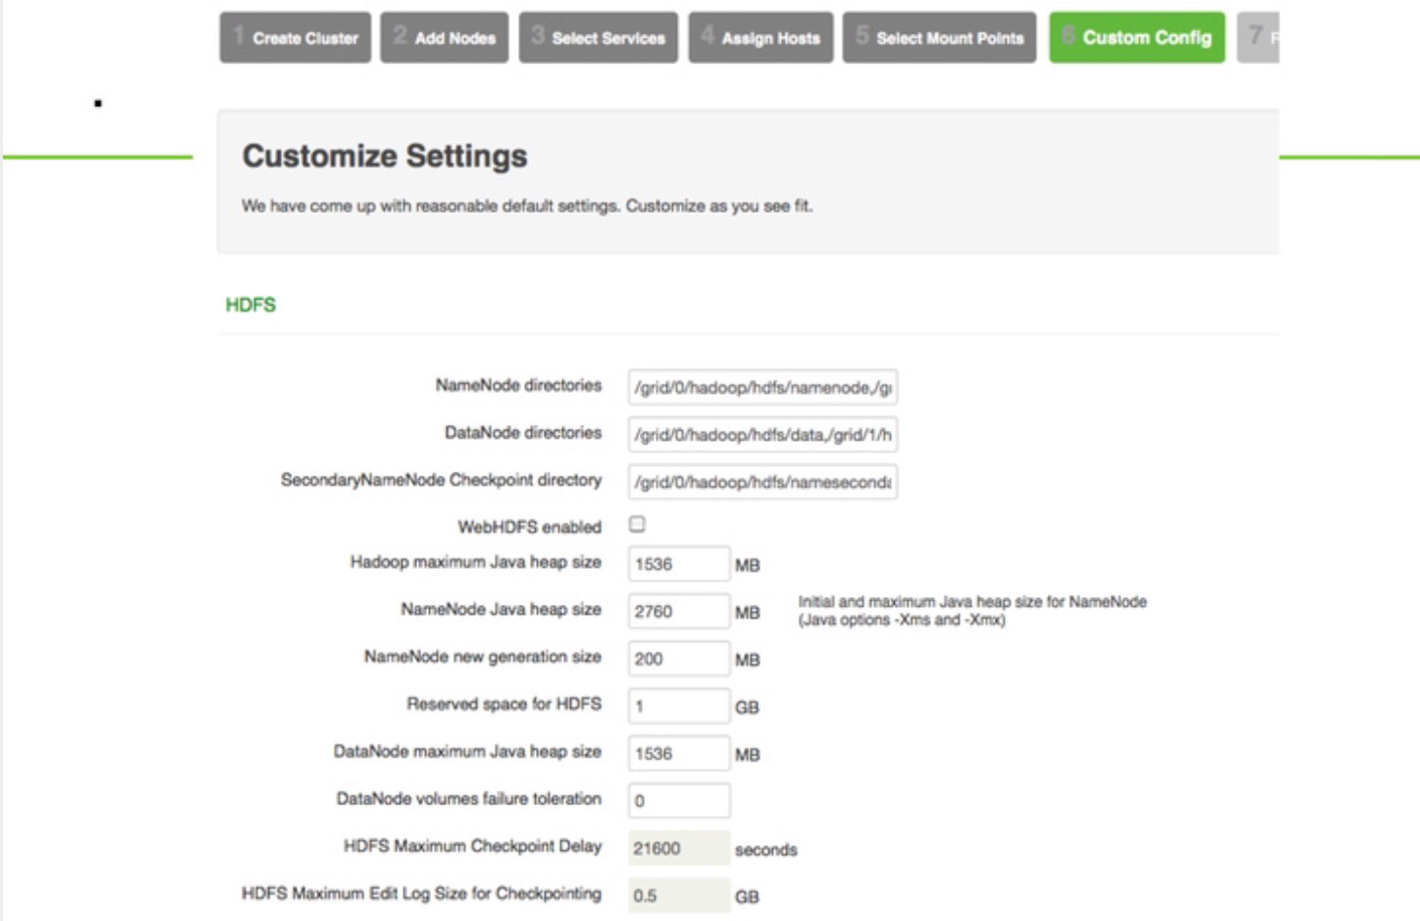
Hadoop Ecosystem
Ambari Custom Configuration

Slide 14
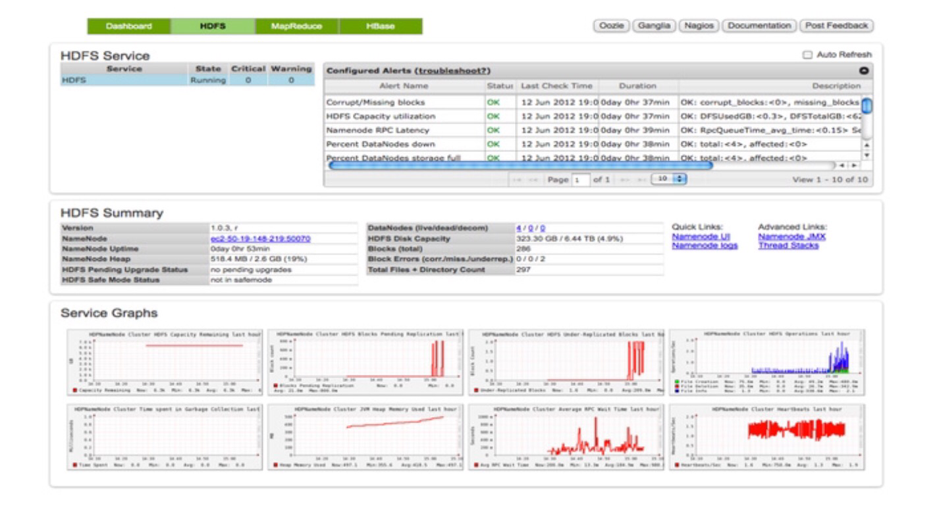
Hadoop Ecosystem
HDFS Dashboard

Slide 15
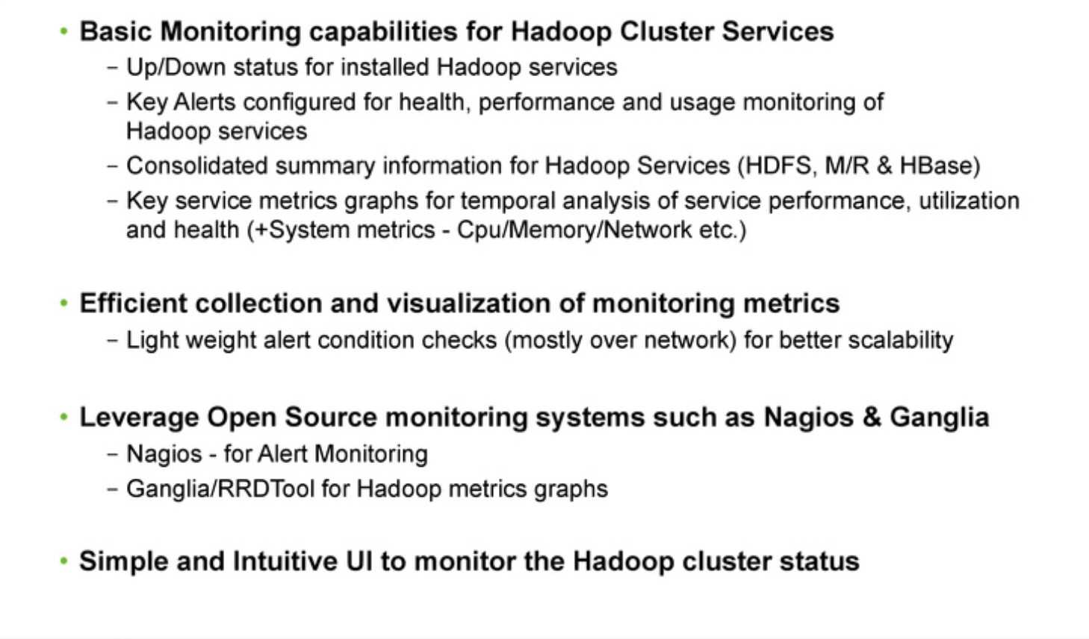
Hadoop Ecosystem
Monitoring Ambari

Slide 16
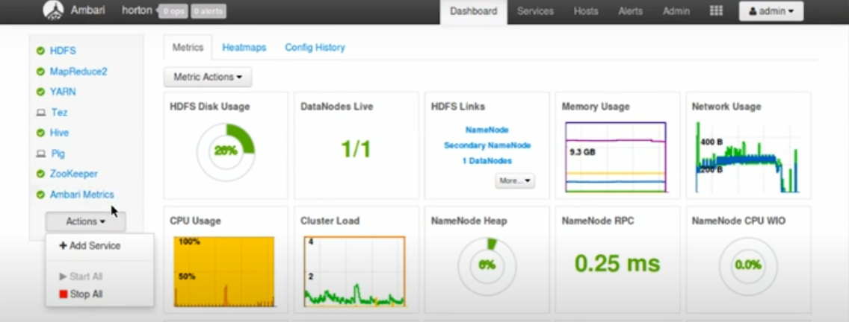
Hadoop Ecosystem
Ambari View

Slide 17
THANK YOU
“WORLD IS ONE BIG DATA PROBLEM”
“TORTURE THE DATA AND IT WILL CONFESS TO ANYTHING”

